Slide 1
Resource Access Protocol
By Sheikh Muhammad Adib

Slide 2
Real Time System
Produce the right result on the right time
Predictability

Slide 3
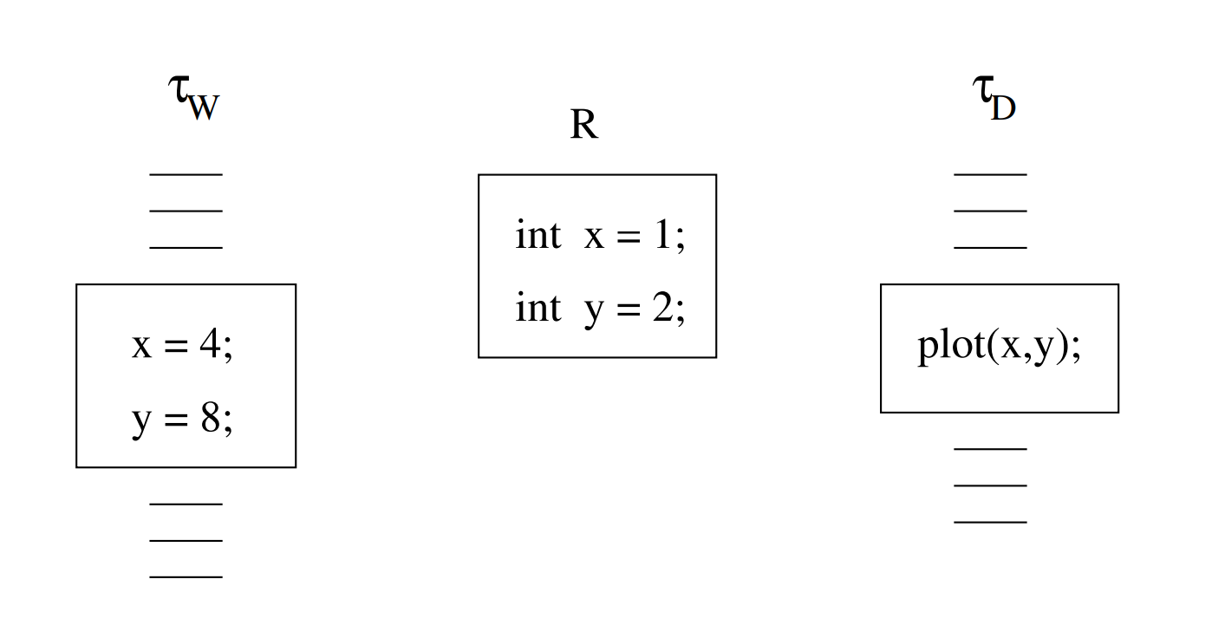
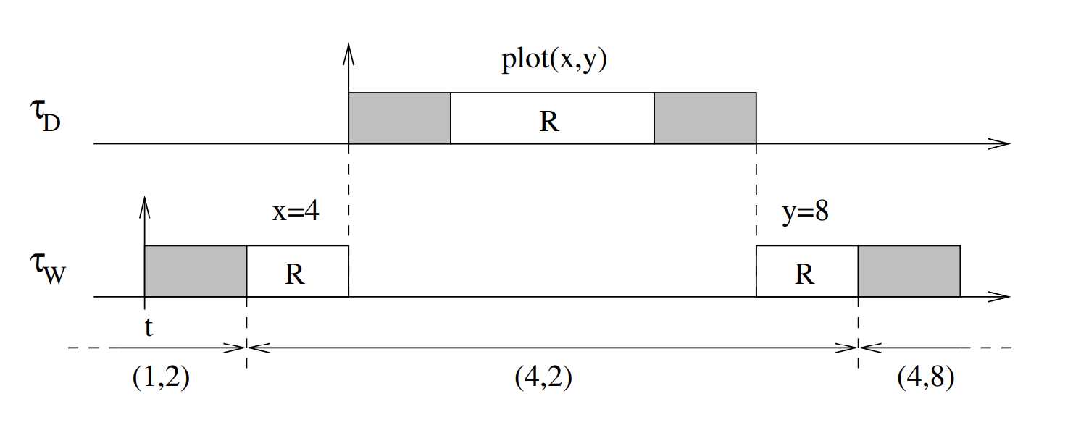

Two task sharing a resource
Data inconsistency !!!

Slide 4
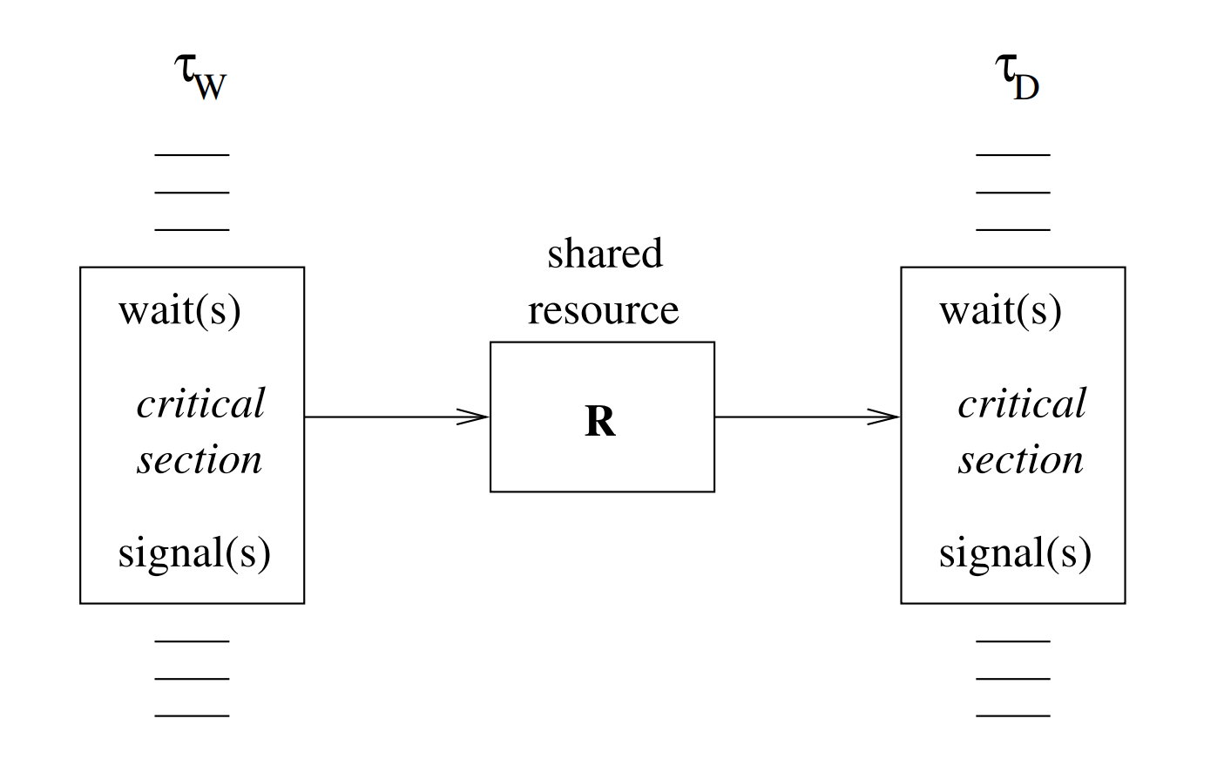
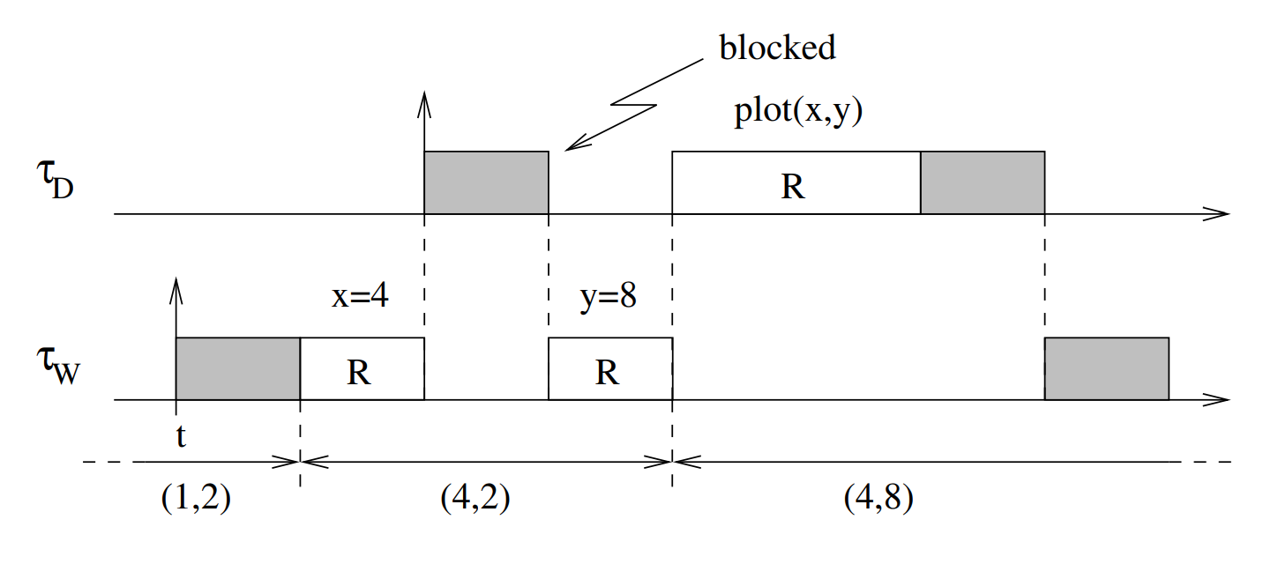
Synchronization : Semaphore
Semaphore

Slide 5
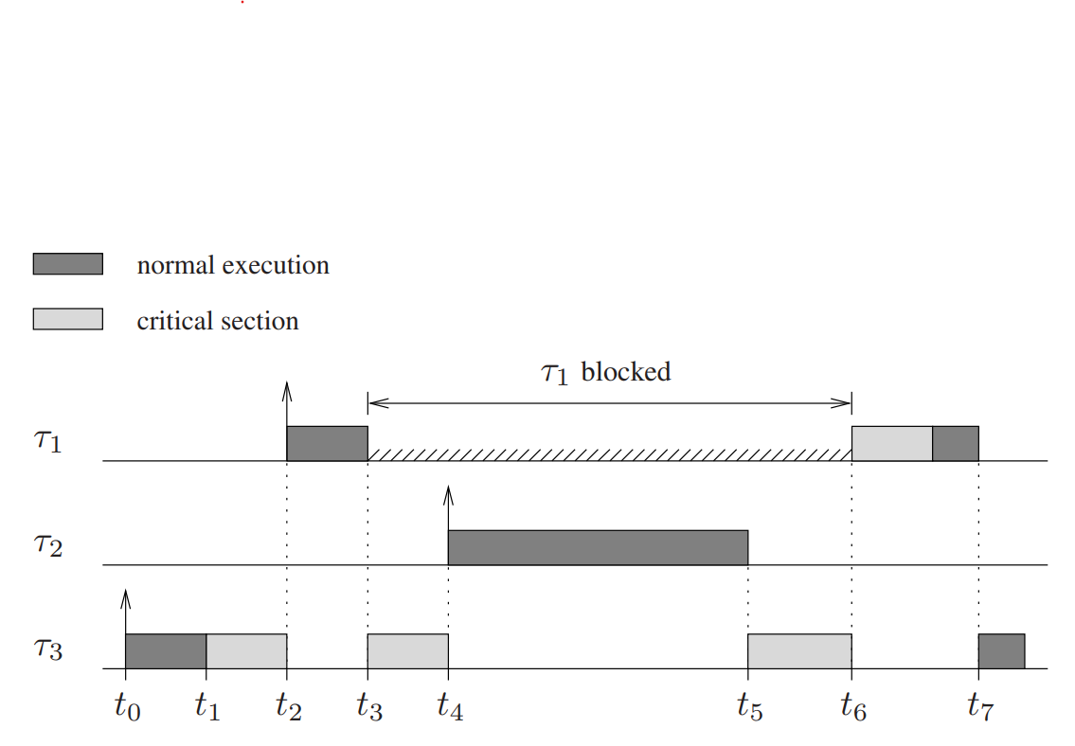

Priority Invention
${\text{τ}}_{1} Highest priority$
${\text{τ}}_{2} Medium Priority$
${\text{τ}}_{3} Lowest Priority$

Slide 6
Resource Access Protocol
Ensure that highest priority task can complete before its deadline and reduce the blocking time experienced by highest priority task.

Slide 7
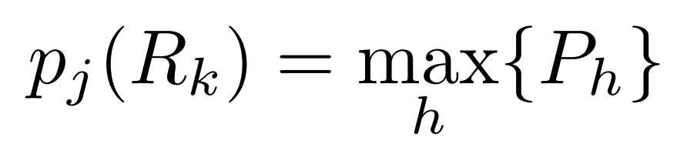
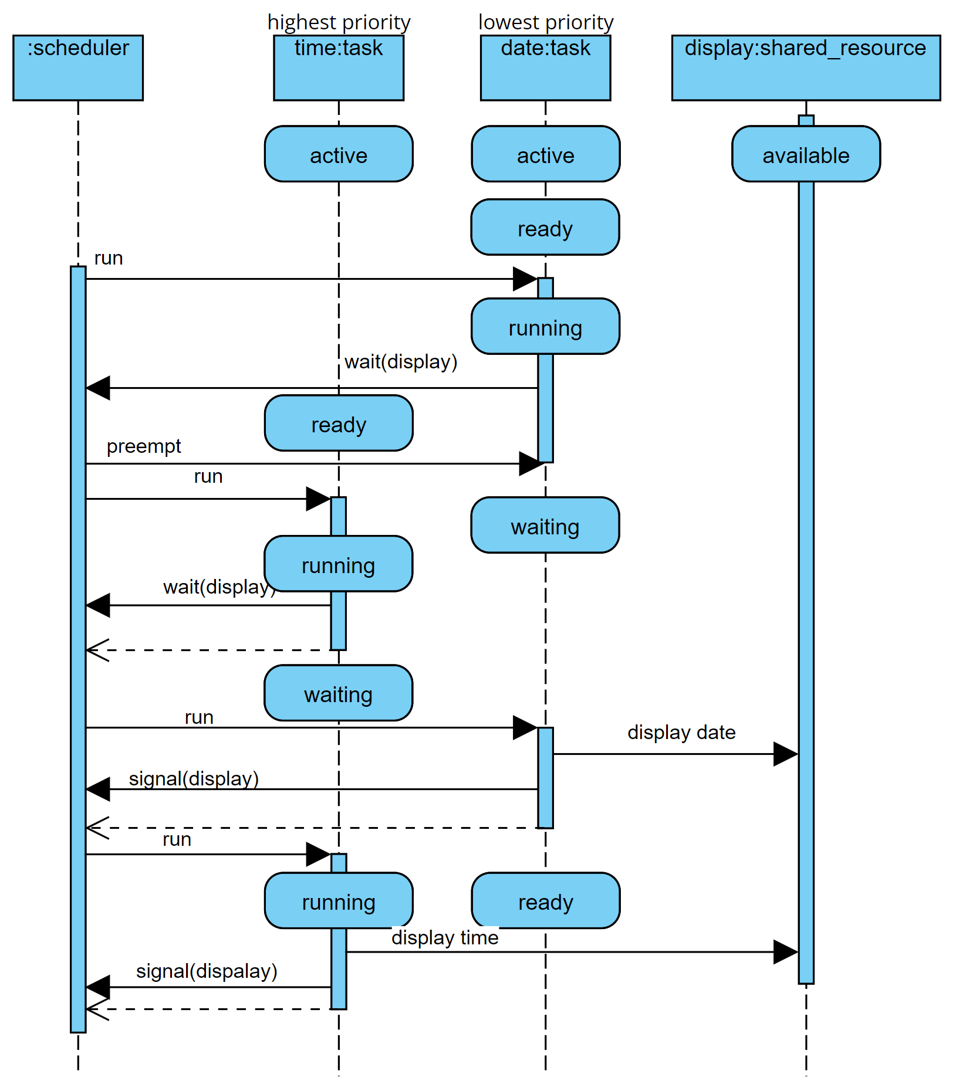
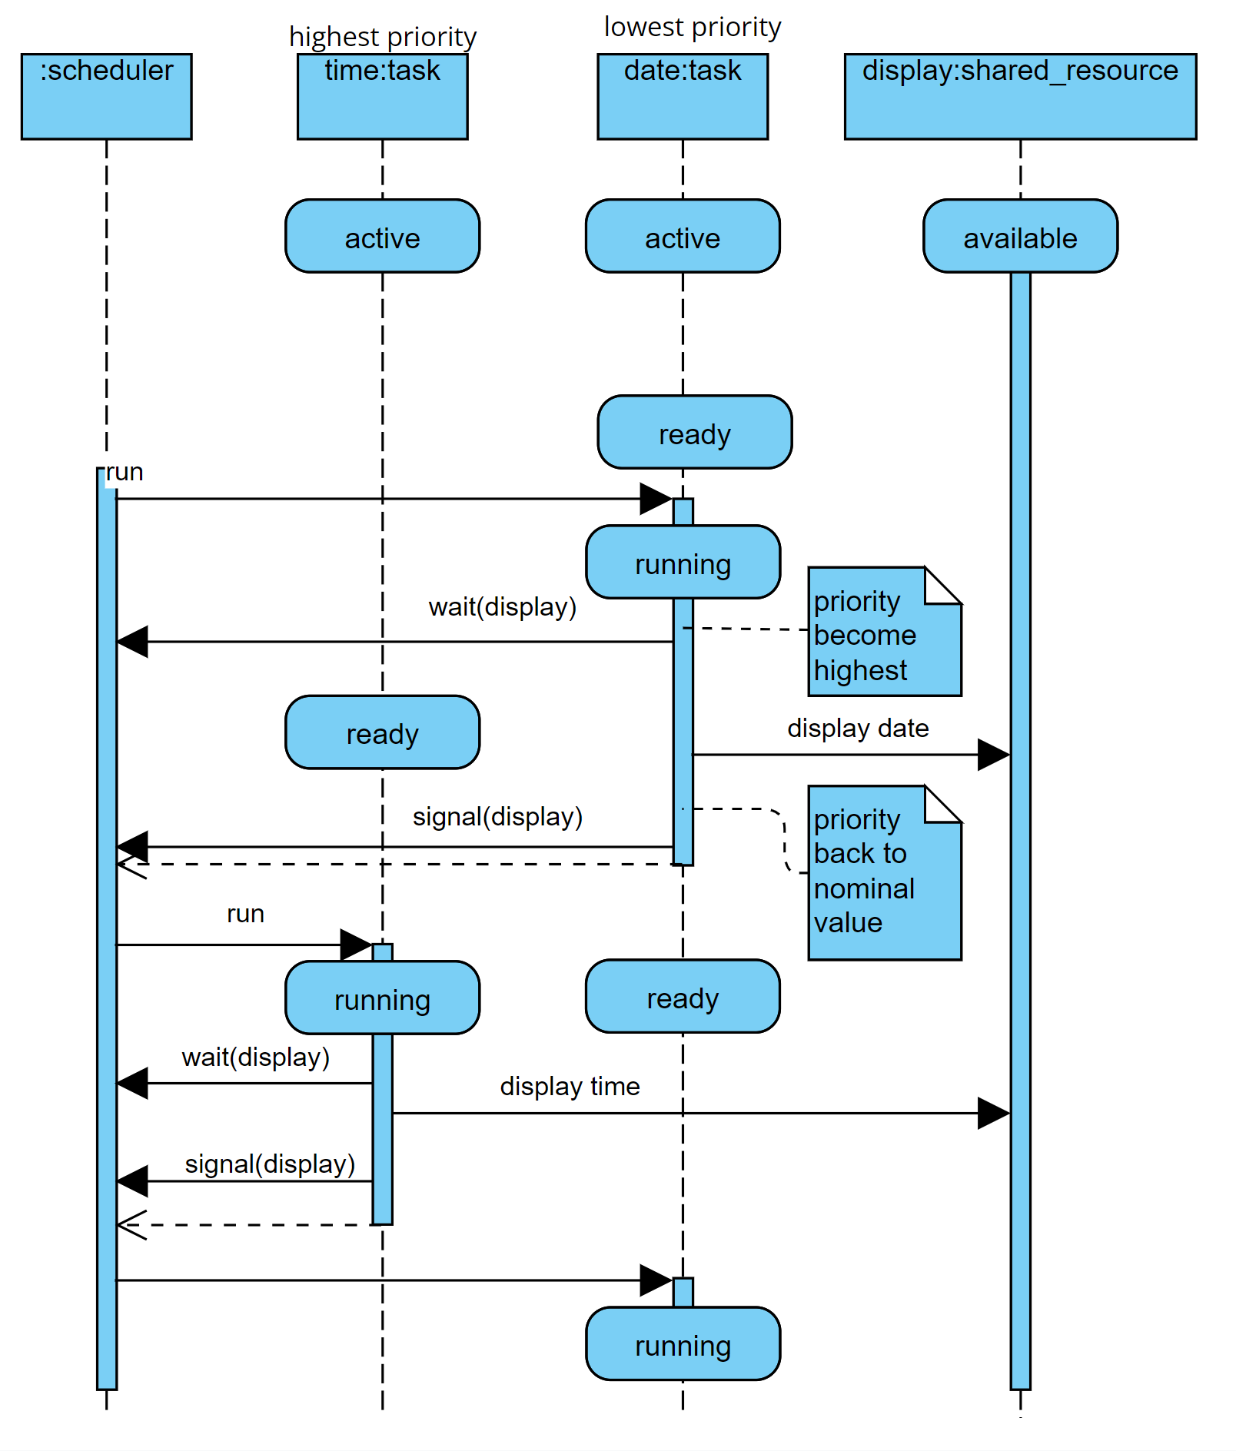

Non-Preemptive Protocol
UPPAL model

Slide 8
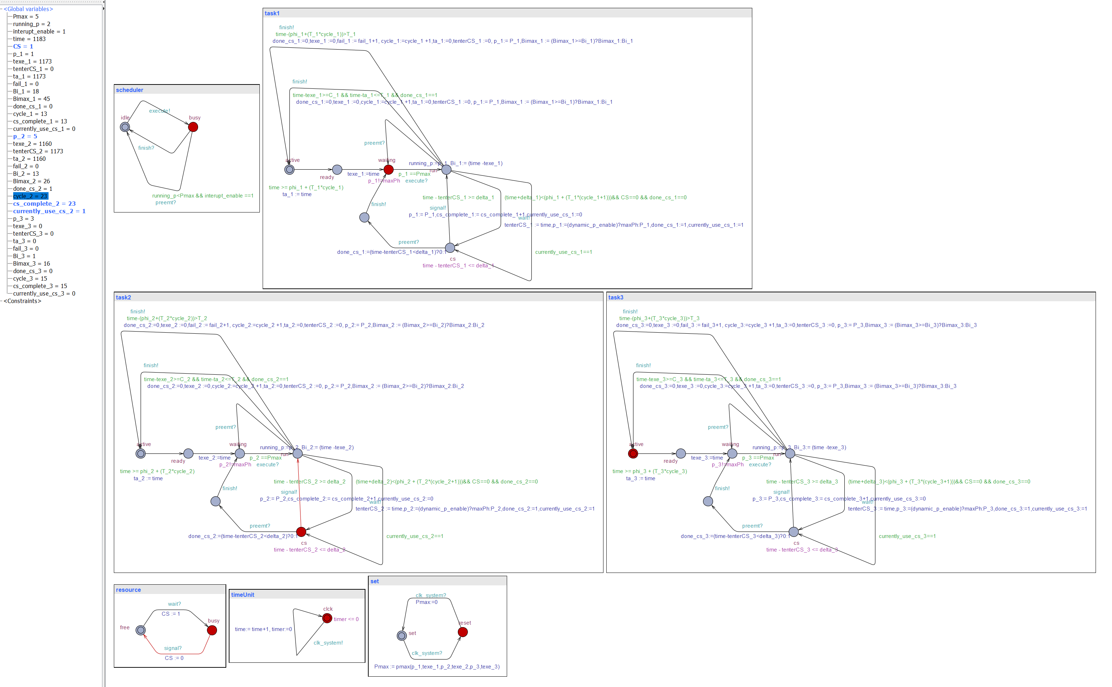
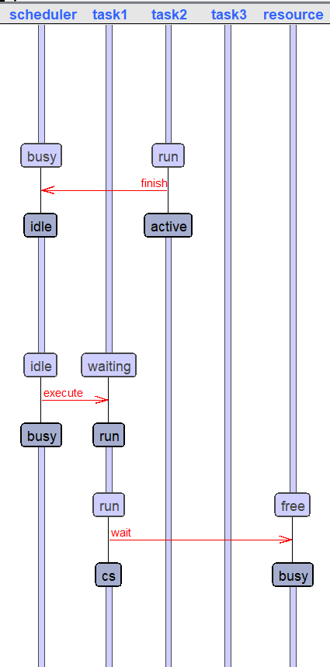
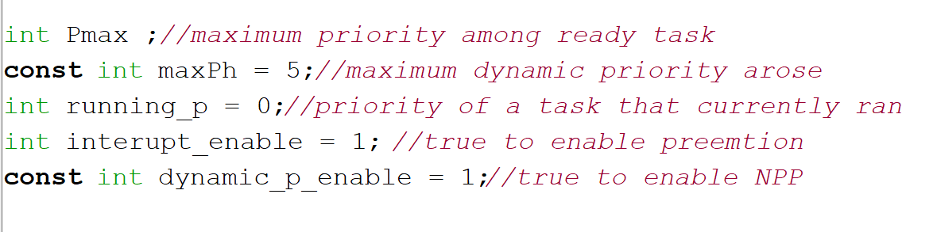
UPPAAL model for NPP
Model can be access here : Adib6637/UPPAAL (github.com)

Slide 9
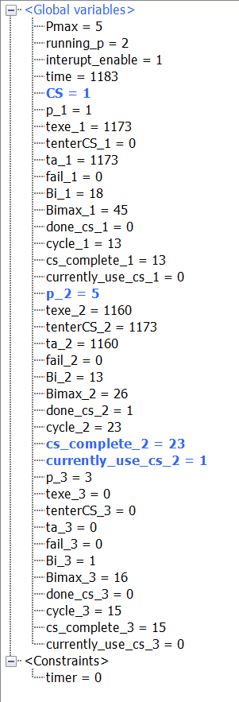
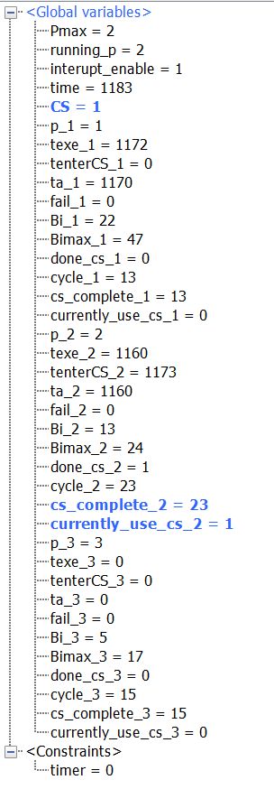
Compare them
With NPP
Without NPP

Slide 10
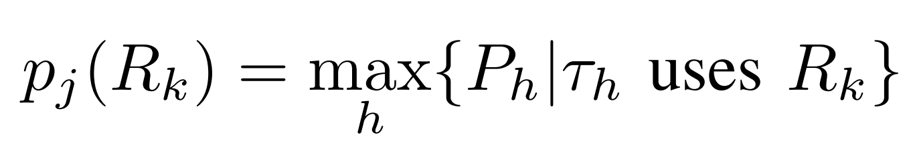
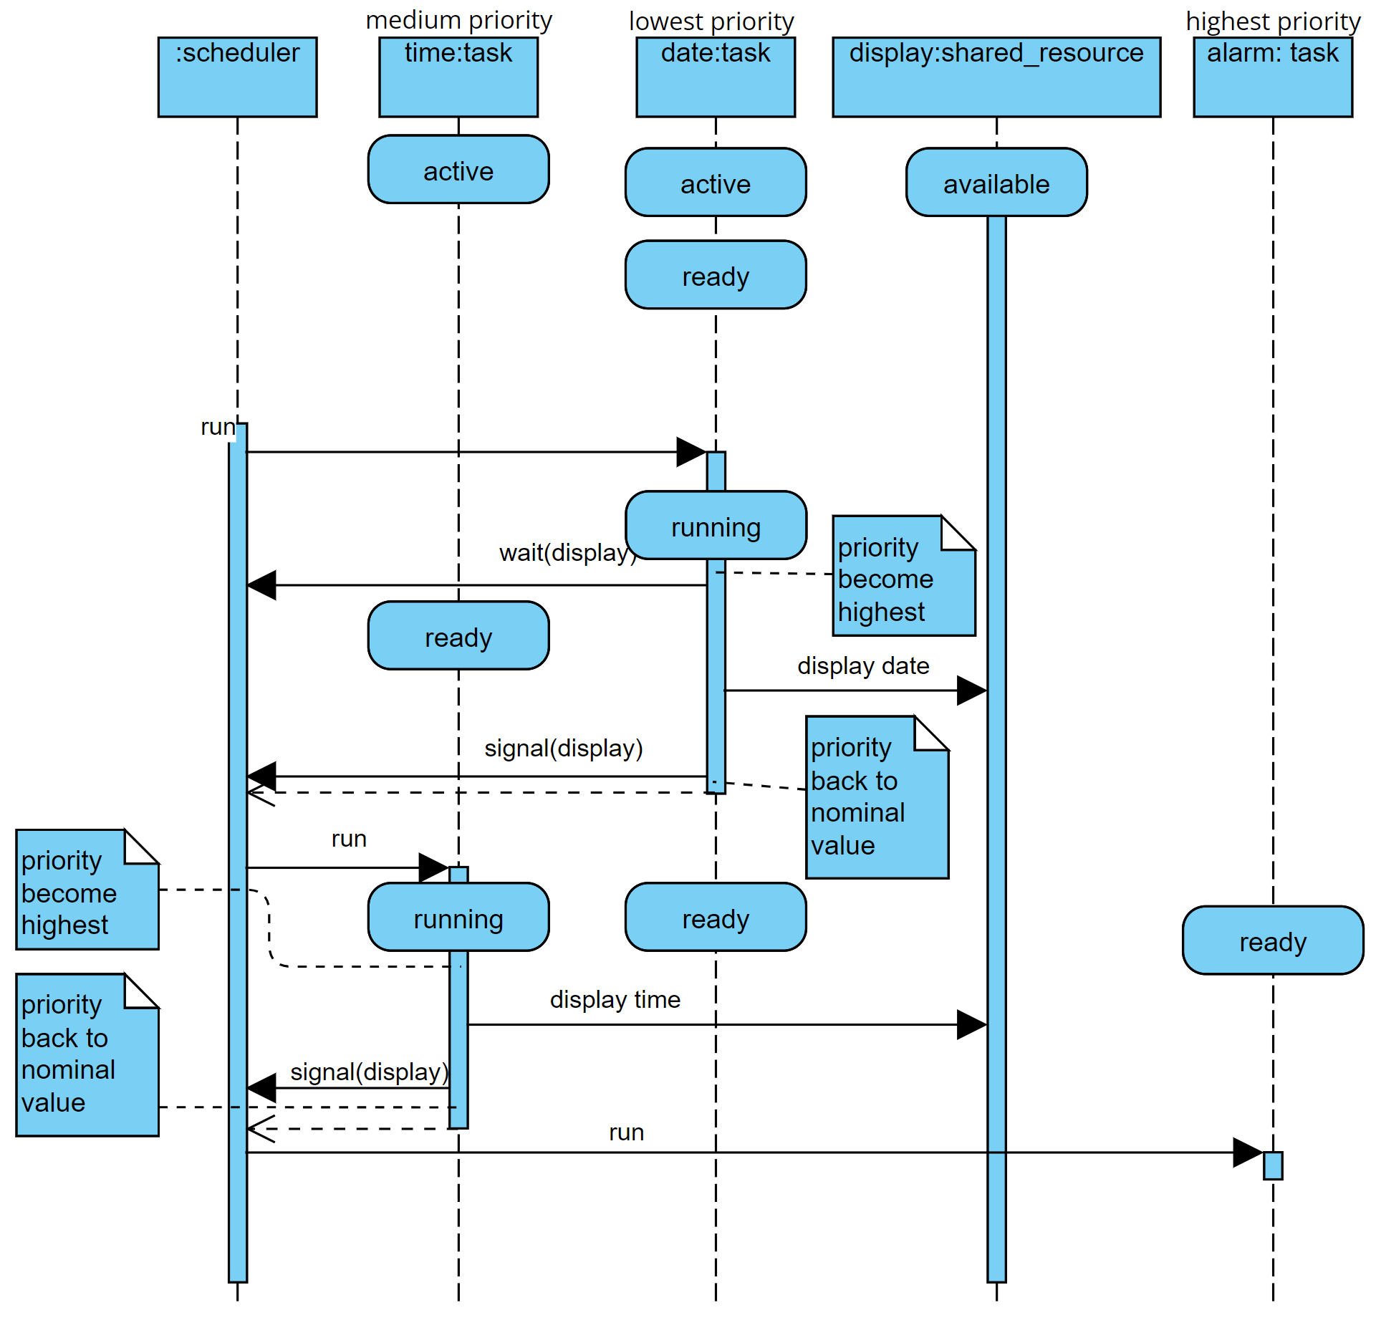
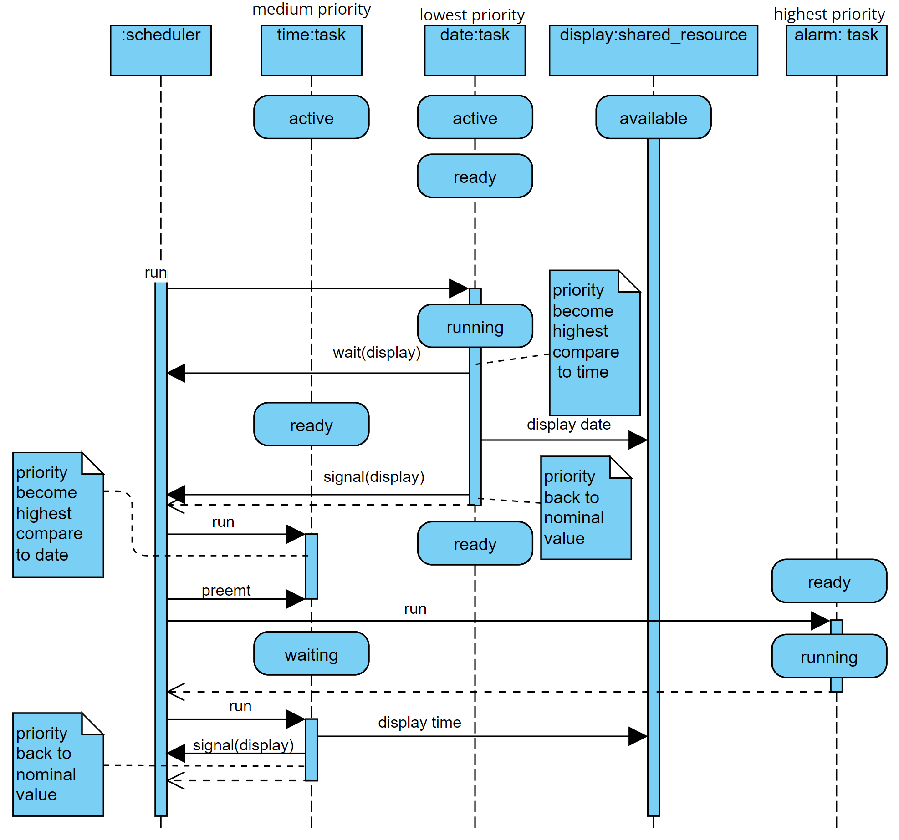
Highest Locker Priority

Slide 11
Thank You

Slide 12
Reference
Giorgio C. Buttazzo. Hard real-time computing systems: predictable scheduling algorithms and applications. Real-time systems series. Springer, 3rd ed edition. OCLC: ocn741541202.
IEEE. IEEE Std 2050-2018: IEEE Standard for a Real-Time Operating System (RTOS) for Small-Scale Embedded Systems. IEEE. OCLC: 1053697231.
UPPAL model for Non-Preemptive Protocol : Adib6637/UPPAAL (github.com)

